Slide 1
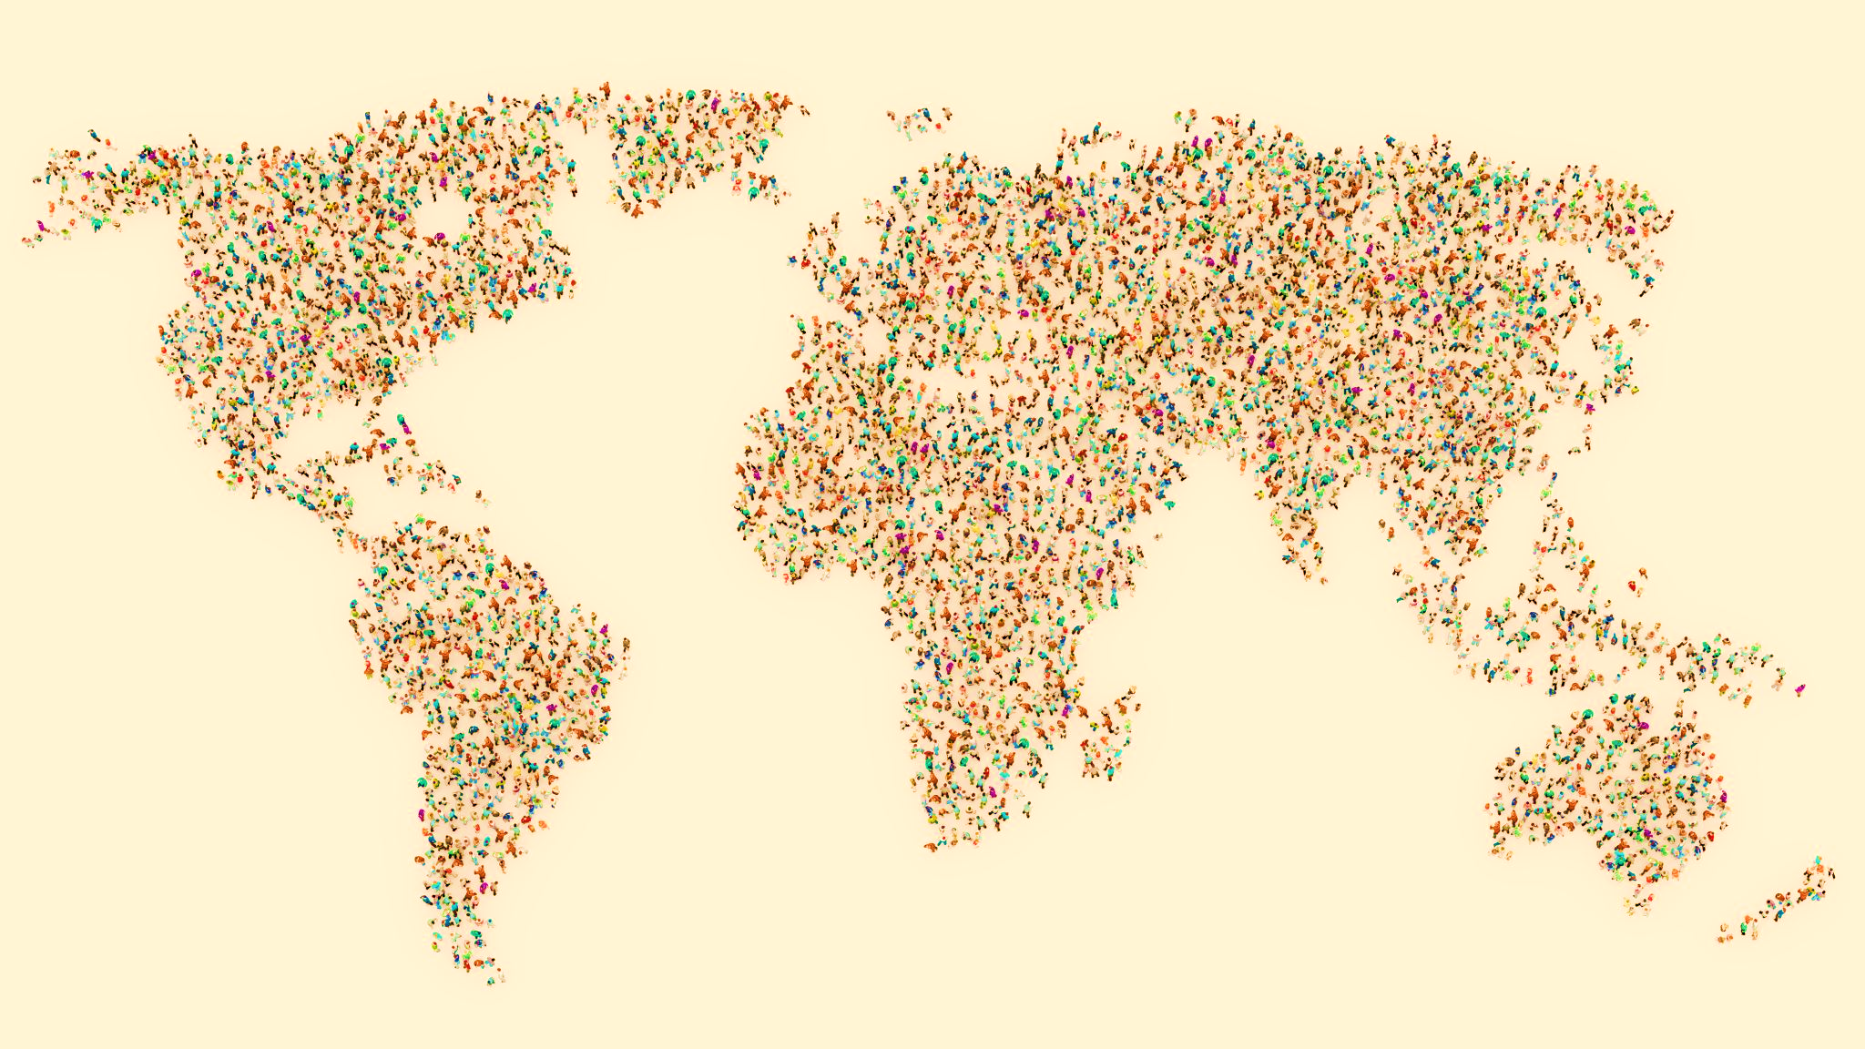
World Happiness Analysis 2019
Data Analyst Programme – SQL Project 2
Jessica Casares – Data Analyst
June 2026

Slide 2
Project Brief
This project is set to analyse 156 countries’ happiness data from 2019
The objective is to determine the relationship between key metrics that may influence the final happiness score for each country. We will analyse information such as GDP per capita, social help, perception of corruption or generosity, among others
We will answer questions such as:
Are the happiest countries the ones with the biggest GDP per capita?
Does perception of corruption have an impact on the happiness of the country?
Is GDP per capita the only factor that affects the happiness score?
How much does social support affect the happiness score?
How many countries are in the top list as happiest?

Slide 3
Dataset Overview
Total rows: 156
Columns: 9
Number of countries: 156
Data recorded:
Name of the country
Score (This represents happiness score)
GDP per capita
Social support
Healthy Life Expectancy
Freedom to make life choices
Generosity
Perception of corruption (the biggest number equals less perception)
The data has been a key part in solving the main business questions and goals of the project

Slide 4
Country's Name | Happiness Score
Finland | 7.77
Denmark | 7.6
Norway | 7.55
Iceland | 7.49
Netherlands | 7.49
Switzerland | 7.48
Sweden | 7.34
New Zealand | 7.31
Canada | 7.28
Austria | 7.25
Australia | 7.23
Costa Rica | 7.17
Israel | 7.14
Luxembourg | 7.09
United Kingdom | 7.05
Ireland | 7.02
Germany | 6.99
Belgium | 6.92
United States | 6.89
Czech Republic | 6.85
United Arab Emirates | 6.83
Malta | 6.73
Mexico | 6.6
France | 6.59
Taiwan | 6.45
Chile | 6.44
Guatemala | 6.44
Country's Name | Happiness Score
Finland | 7.77
Denmark | 7.6
Norway | 7.55
Iceland | 7.49
Netherlands | 7.49
Switzerland | 7.48
Sweden | 7.34
New Zealand | 7.31
Canada | 7.28
Austria | 7.25
Australia | 7.23
Costa Rica | 7.17
Israel | 7.14
Luxembourg | 7.09
United Kingdom | 7.05
Ireland | 7.02
Germany | 6.99
Belgium | 6.92
United States | 6.89
Czech Republic | 6.85
United Arab Emirates | 6.83
Malta | 6.73
Mexico | 6.6
France | 6.59
Taiwan | 6.45
Chile | 6.44
Guatemala | 6.44
Global Happiness Rankings
(Highest to lowest)

Slide 5
Top 10 Happiest vs 10 Least Happy Countries

Slide 6
General Data Information
General Global Data Analysis
Total Number of Countries
156
Avg Happiness Score
5.41
Avg GDP per Capita
0.91
Happiest Country
Finland
Avg Social Support
1.21
Avg Healthy Expectancy
0.73
Less Happy Country
South Sudan
Avg Freedom to make life choices
0.39
Avg Generosity
0.19
Highest GDP per capita
Qatar
Avg Corruption’s perception
0.11

Slide 7
Key Metric Highlighted: Average Global Happiness Score
Number of Countries above Avg
77
Avg Happiness Global Score
5.41
Avg Happiness Global Score
5.41
Number of countries below Avg
79
Number of countries below Avg
79

Slide 8
Highest GDP per capita country vs Global Average Happiness
Highest GDP per capita Country
Qatar

Slide 9
Top 5 Countries with the Highest Social Support

Slide 10
Top 5 Countries Ranked by Healthy Life Expectancy

Slide 11
Relation between the perception of corruption and the happiness score
Data shows that a lower perception of corruption directly leads to a higher happiness score

Slide 12
Generosity vs happiness correlation

Slide 13
Countries with the largest difference between GDP rank and happiness rank
Country's Name | gdp_ranking | happiness_ranking | difference
Botswana | 65 | 148 | 83
Guatemala | 100 | 26 | 74
El Salvador | 102 | 35 | 67
Hong Kong | 9 | 75 | 66
Uzbekistan | 106 | 41 | 65
Nicaragua | 110 | 45 | 65
Iraq | 65 | 126 | 61
Iran | 56 | 117 | 61
Costa Rica | 69 | 12 | 57
Honduras | 115 | 59 | 56
Tajikistan | 126 | 74 | 52
Egypt | 87 | 137 | 50
Sri Lanka | 81 | 129 | 48
Kuwait | 4 | 51 | 47
Pakistan | 112 | 67 | 45
Kosovo | 90 | 46 | 44
Somalia | 156 | 112 | 44
Gabon | 61 | 104 | 43
Bolivia | 103 | 61 | 42
Brazil | 72 | 32 | 40
Bulgaria | 57 | 97 | 40
Jamaica | 95 | 55 | 40
The table highlights only countries that have a difference of 40 positions or more in their rankings.
For differences of 40 positions or fewer, the correlation between the two rankings tends to be typical
Additionally, this table illustrates that sometimes a high GDP per capita does not always correlate with a high happiness score

Slide 14
GDP Rank
vs Happiness Rank

Slide 15
Happiness Category Distribution
Categories
High score>= 7
Medium score >= 4.5
Low score <=4.4

Slide 16
Top 5 countries with high social support
&
freedom to make life choices
Only top 5 Social support
Iceland
Denmark
New Zealand
Only top 5 Freedom to make life choices
United Arab Emirates
Cambodia
Uzbekistan
Both top 5 lists
Finland
Norway

Slide 17
Key Findings
The highest happiness scores are associated with GDP per capita, social support, and the freedom to make life choices
Corruption perception has a direct negative impact on happiness scores
Healthy life expectancy is another key factor influencing happiness scores
High levels of social support and the freedom to make life choices are essential for achieving a positive happiness score

Slide 18
Recommendations
Review and strengthen anti-corruption laws to enhance the perception of the country's residents.
Improve social well-being measures and identify areas where policies can be improved for a better quality of life.
Investigate countries with a high GDP per capita but lower happiness scores to determine possible causes. Consider factors such as a lack of social support or high levels of perceived corruption.
Implement some of the proposed policies and conduct a follow-up analysis in the future to compare the results.

Slide 19
Data Analyst Programme – SQL Project 2
Jessica Casares – Data Analyst
June 2026

